Slide 1
Going Live

Slide 2

Reminder - You have Homework!
Really, work hard on this assignment! This assignment introduces you to fundamental concepts that we’ll be building the entire course-long.
Review In Class Material, especially Exercises
Work with your peers! It’s much better than screaming at your computer alone.
Ask Questions on Slack! Your peers, TAs, and Instructors are all here to help when they can.
Due Thursday at 11:59PM

Slide 3
Admin Items

Slide 4




Difference?
.VS.

Slide 5


Clone Down
New Content (UCB-.....)
Push Up
Your Work (my-class-repo)
Copy Over

Slide 6
Pull Down
git pull origin master
Push Up
git add . , git commit -m “Message”,
git push origin master
Copy Over

Slide 7

Today’s Objectives
To recap the basic topics covered to date
To engage in a deep dive of HTML/CSS for layout design and element positioning
To offer a conceptual introduction to CSS reset
To work with Google Developer tools for site inspection
To utilize Github Pages for website deployment
Topics
CSS Positioning
Chrome Inspector
CSS Resets
Deploying to Github Pages

Slide 8

Setting Expectations
Don’t expect to understand everything at once. Today is all about getting immersed.

Slide 9

Where you Are
Your comfort zone

Slide 10

Brace yourselves...
Today is gonna be a bit tough.
But trust us. It will all look easy in a few weeks.

Slide 11
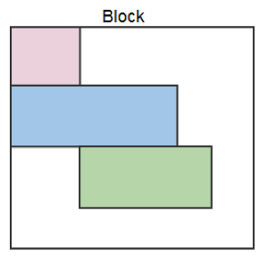
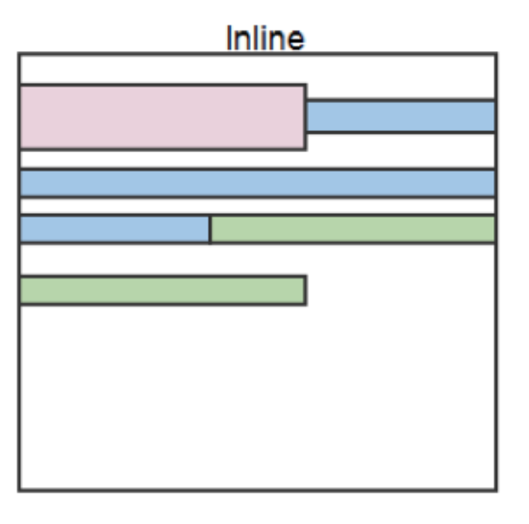
Block Elements
By default, web clients render many HTML elements as block elements. Paragraphs, headers, divs and more receive this treatment.
A block element will take up an entire line of space—unless you intervene with CSS properties.
Block: p. H1 -h6. ol, ul, div…
Inline: span, code, button, etc…

Slide 12
We all float down here

Slide 13

The Concept of Flow
By default, every HTML element displayed in the browser is governed by a concept called flow.
This means that HTML elements force their adjacent elements to flow around them.

Slide 14
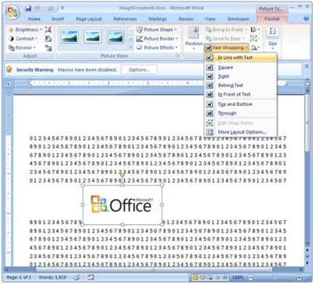
An Analogy...
This concept of “flow” is very similar to the wrap-text options you may be familiar with in Microsoft Word.
Just as in MS Word, you can have images in-line with text, on-top of text, etc.

Slide 15
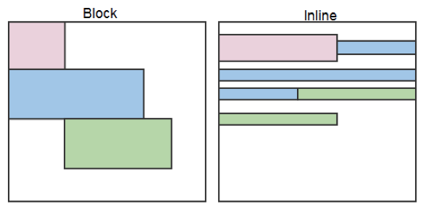
Block vs Inline Elements
Now contrast the block elements with inline elements.
By using float CSS properties, we can command our website to display multiple HTML elements adjacently.

Slide 16
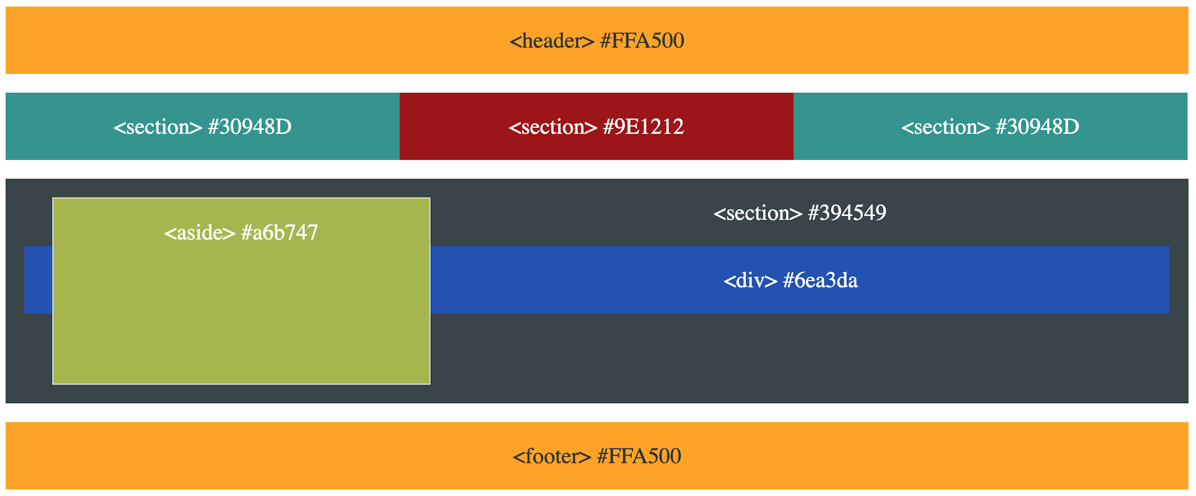

Review!
11-FloatLayout-Activity

Slide 17
Let’s Recap…
What is CSS?

Slide 18

HTML/CSS Definitions (yawn - boring!)
HTML: Hypertext Markup Language – (Content)
CSS: Cascading Style Sheets – (Appearance)
HTML/CSS are the “languages of the web.” Together they define both the content and the aesthetics of a webpage – handling everything from the layouts, colors, fonts and content placement. (JavaScript is the third – handling logic, animation, etc.)

Slide 19


An Analogy...
HTML alone…
Like writing in Notepad…
Can only write unformatted text
boring
HTML with CSS
Like writing papers in Microsoft Word
Can format text, page settings, alignment, etc. based on “highlighting” and menu options.
you can do this
Please don’t though

Slide 20
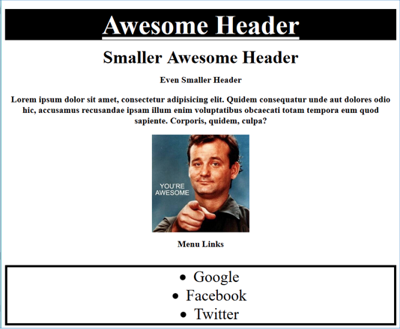
CSS Stylin’

Slide 21
How do you style HTML...
Elements? Classes? IDs?

Slide 22
CSS Syntax
CSS works by hooking onto selectors added into HTML using classes and identifiers.
Classes use .classname, IDs use #idname, and elements use just their name.
Once hooked, we apply styles to those HTML elements using CSS.
selector
property
value
declaration end
a
{
background-color
:
yellow
;
}
declaration start
property/value separator
declaration separator

Slide 23
CSS Positioning

Slide 24
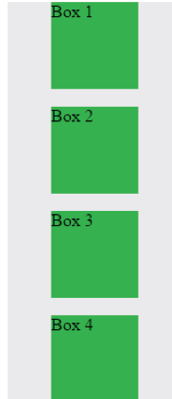
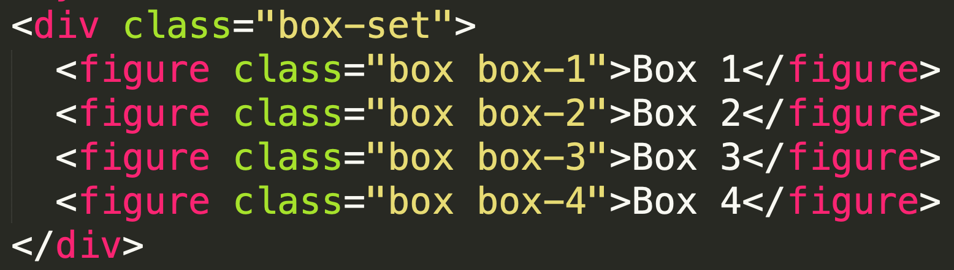
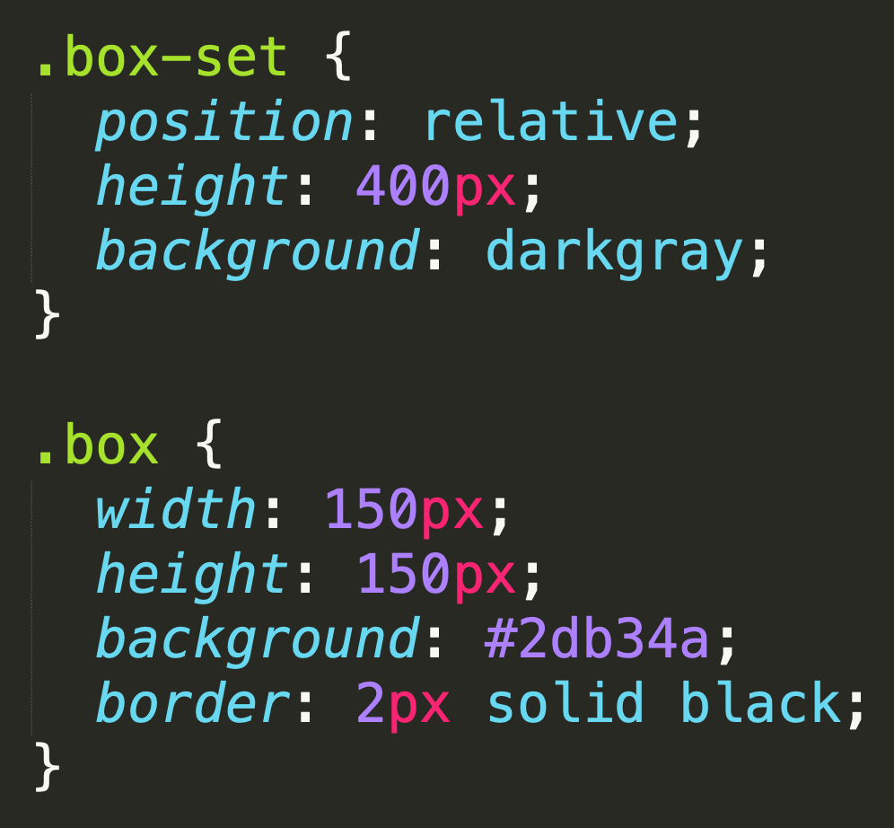
Position Static (default)

Slide 25
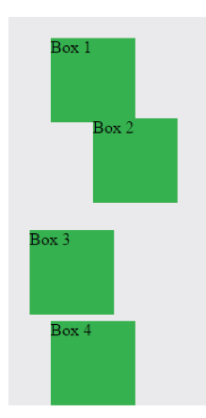
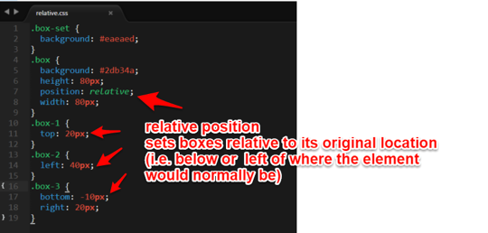
Position Relative
Switching the boxes to relative will nudge the boxes in relation to their “original” location.

Slide 26
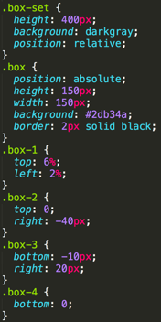
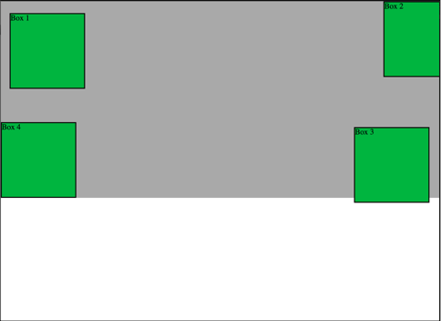
Position Absolute
Positioned relative to nearest positioned ancestor

Slide 27
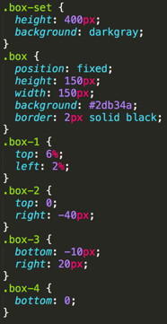
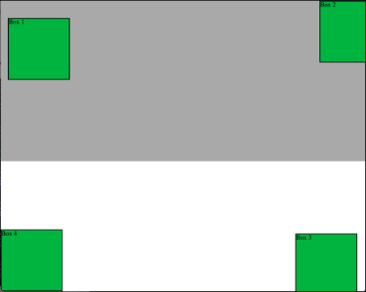
Position Fixed
Position with exact coordinates to the browser window

Slide 28
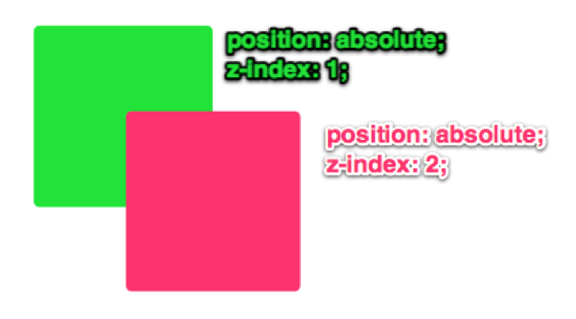
Z-Index
Z-Index allows you to layer elements on top of each other when they’re positioned.

Slide 29
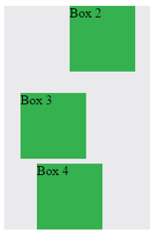
Hiding Things
“Display: none;” allows us to hide elements from view.
This will become useful in later sections, when we’ll be hiding and revealing specific HTML elements of our choice.
Hides element as if it's not there (compare with "visibility: hidden;").
"visibility: hidden;" hide the element takes up the same amount of the same amount of space
"display: none;" takes the element out of the "Flow"

Slide 30
Code Walkthrough
12-CSS_PositionedLayout

Slide 31

Your Turn
Activity: 13-CSS_Positioned_Activity
Suggested Time: 30 mins
Assignment
In this activity, you’ll flex your newfound positioning skills by creating another conceptual layout. Eyeball the design to your best ability.
Work in pairs on this activity, but make sure each member of the group is typing out their own code!
Check Gitlab README for additional instructions.

Slide 32

Do It Again!
Re-do this at home! We designed this exercise
to firm up your HTML/CSS skills.
REMEMBER: The best way to learn web development is to PRACTICE!

Slide 33
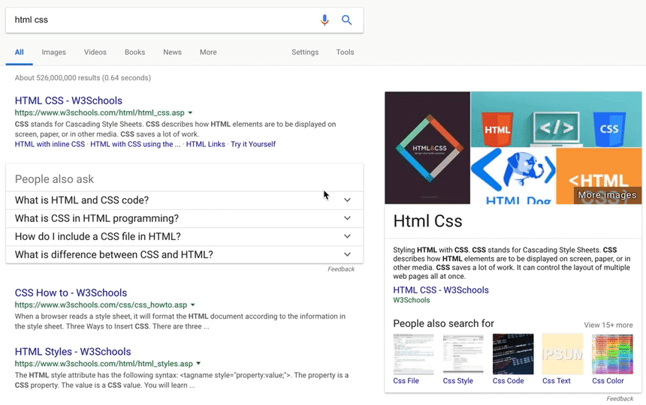
Chrome Inspector
To access chrome inspector, right click on a page. Then hit “Inspect.”
It will allow you to inspect the HTML, CSS and more!
You can even edit the HTML/CSS of a webpage and instantly view your changes in the browser!
This works on any website, whether yours or not.

Slide 34
Your Turn
Activity: Chrome Inspector Tools | Suggested Time: 15 mins
Assignment
For the next 15 minutes, take a website you commonly use (Amazon, Google, Huff Post, etc.) and heavily modify it using the Chrome Developer Tools.
Be sure to at least modify:
Content (Change words)
Colors
Spacing
Send a screenshot to the class’s slack profile when you’re done.

Slide 35

It’s Lunch Time!
Return @ XX:XX

Slide 36
More Inspector!
Activity: Chrome Inspector Tools | Suggested Time: 10 mins
Assignment
For the next 10 minutes, edit any site that you’ve been working on in-class or for homework with Chrome Developer Tools.
Be sure to at least modify:
Content (Change words)
Colors
Spacing
Send a screenshot to the class’s slack profile when you’re done.

Slide 37
CSS Reset

Slide 38

Multiple CSS Files
An incredibly powerful technique: deploying multiple CSS files simultaneously.
This lets developers to create complex designs made up of abounding design elements.
Just remember: the loading order matters!!!

Slide 39
Code Walkthrough
1-3_CSSFiles.html | 03-MultipleCSS

Slide 40
What browser do you use?
If it’s Internet Explorer, you can leave the classroom now...

Slide 41

Battle of the Browsers
Under the hood, web browsers often render web pages differently than their competition.
These disparities could mean HTML/CSS displaying differently in each web client.
Because of these potential divergences, web developers need to make their websites cross-browser compatible.

Slide 42
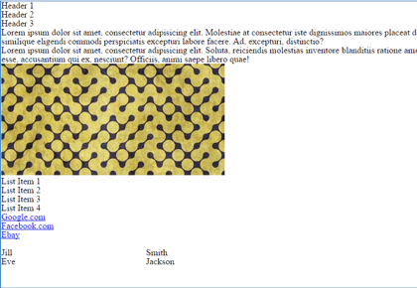
Reset.css & Normalize
Reset.css will “reset” all browser-specific CSS. This means your site will appear the same in all browsers.
However, you will have to re-style everything yourself.
Why it Matters
It’s important for creating browser-compatible websites
It’s an example of using someone else’s CSS in your website!!!
It’s a common Front-End Developer Interview question.

Slide 43
Your Turn!
Activity: 04-ResetCSS | Suggested Time: 10 mins
Assignment
Follow the instructions given in gitlab to incorporate a reset.css file into a basic HTML file. Note the impact the reset file makes after its inclusion.
Bonus: See how the impact it has on your homework.

Slide 44
Code Walkthrough
example.html | 04-ResetCSS

Slide 45
Let’s git comfortable with GitHub

Slide 46
Deployment & Markdown
-Your website and You-

Slide 47

GitHub Pages
The World will see our greatness!
GitHub provides hosting for static websites – which means we can deploy our websites and applications onto their servers for the world to see.
So… Let’s all login to GitHub now...

Slide 48

GitHub Pages
GitHub has a static hosting site service called GitHub pages that allows you to publish your GitHub repositories on the web!
Your projects will be shown using your own personal URL
username.github.io
Steps
Create a repository with the name ‘username.github.io’
Initialize with a README.md
Add index.html file
Check settings under GitHub Pages section

Slide 49
GitHub Pages Demo

Slide 50
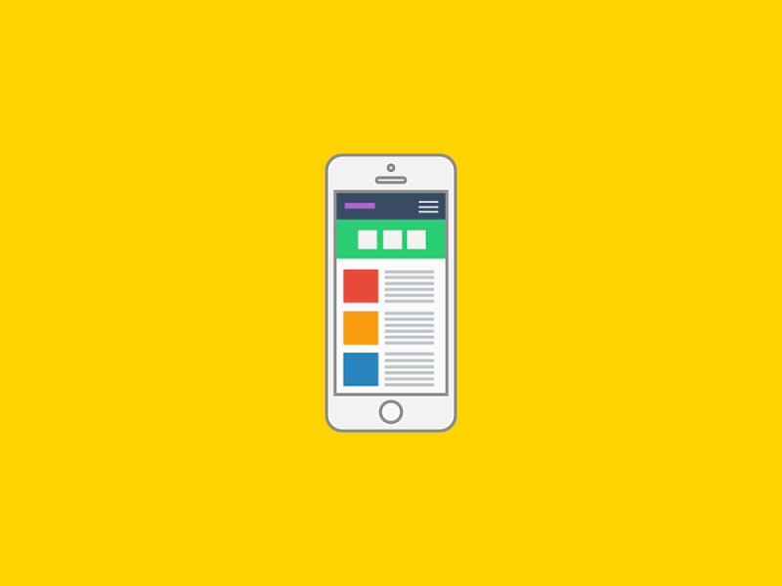
Github Projects
Now it’s time to get our project on Github Pages!
Steps:
Create a repository with any name. Initialize with README
Clone Repo and add index.html with content
Push up to your GitHub Repo
Go to Settings and Deploy project!

Slide 51
GitHub Projects Demo

Slide 52
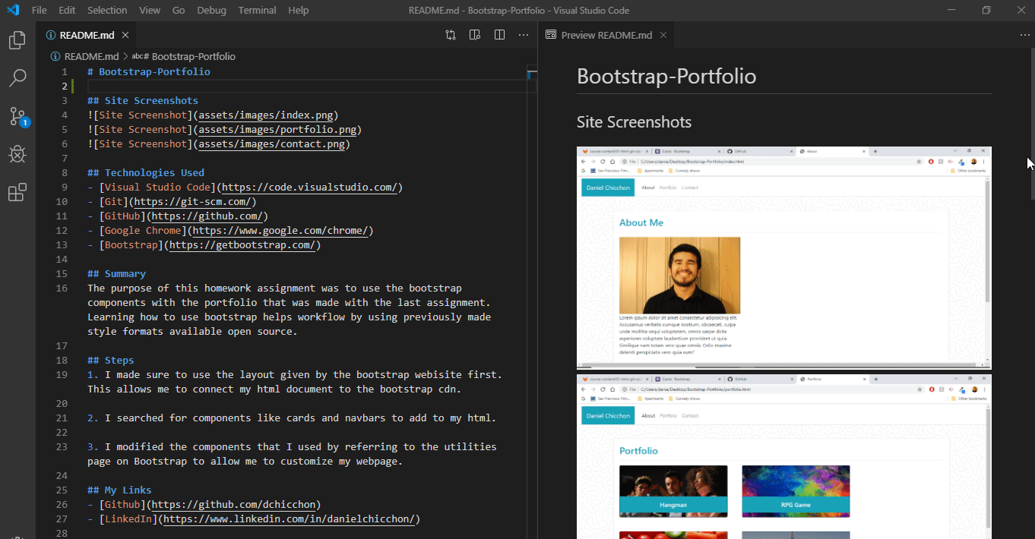
Markdown
Leave a way to explain your project!
Great way to go back to your project after a while
Potential Employers
README.md
Should contain:
A visual to represent your project and show how it functions (GIF, screenshot)
A list of the technologies used (Git, Github, HTML, CSS)
Summary for your project
Author Links towards the bottom
README.md files use markup language, similar to HTML
Markdown Cheatsheet

Slide 53
MARK breakDOWN

Slide 54
Let’s Deploy!
Suggested Time: 15 mins
Assignment
Time to take your newfangled website and deploy it to the cloud (in this case, GitHub Pages).
Additional instructions In Gitlab.
Basic Steps:
Create a new repo that is named `_username_.github.io`
Navigate into a folder and clone the repo into it
Build your files
Add, commit, and push your changes into the repository

Slide 55
DEMO
Homework/Project Deployment

Slide 56
Deploying Projects
Basic Steps:
Create a new repository on your GitHub account. You can name this repository whatever you would like.
Once inside of the repository, create a new file and name it `index.html`
Add some very basic HTML into this file, save it, and then navigate into your repository’s Settings tab.
Scroll down to the GitHub Pages section and then, in the section labeled "Source", select that you would like to use the master branch as your source.
Navigate to `<username>.github.io/<repositoryname>` and you will find that your new web page has gone live!

Slide 57
Your Turn!
Activity: GitHub Pages Project Website | Suggested Time: 15 mins
Assignment
Practice creating github pages with projects. You'll build a website about your favorite type of animal!
Additional instructions in Gitlab.

Slide 58
Bash & git Pair Review

Slide 59
Bash Commands
cd ~ (changes to home directory)
cd .. (moves up one directory)
ls (lists files in folder)
pwd (shows current directory)
mkdir (creates new directory)
touch (creates a file)
rm (deletes file)
rm -r (deletes a folder, note the -r)
open . (opens the current folder. MAC SPECIFIC)
open (opens a specific file. MAC SPECIFIC)
explorer (opens the specific file. BASH SPECIFIC)
explorer . (opens the current folder. BASH SPECIFIC)
mv (mv or rename)
cp (copy files)

Slide 60
git Commands
git clone – copies an entire repo (to begin).
git add – adds a file for inclusion in Git.
git commit – notes a change to the local repo.
git push – sends changes to hosting service.
git pull – downloads freshest version of repo.
git status – check status of your tracked and untracked files
What is Git?
How do we autocomplete?
How do we see previously executed commands?
What is man?
How do we move up a directory?
Can we list the contents of a folder up?
How do we see hidden files? (those that start with a . )

Slide 61

Questions?
Comments Concerns…?

Slide 62

Visit Gitlab
Let’s attempt to Clone down the Repo

Slide 63

Set up your SSH Keys

